Slide 1
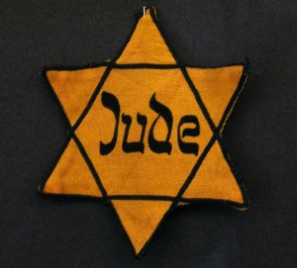
WHO IS RESPONSIBLE CIRCLE GRAPH

Slide 2
Directions
Use the colors listed for each section of your graph.
You must also provide a written explanation as to why you assigned the person(s) amount. Be detailed!
Determine who was responsible for the Holocaust and to what extent they are guilty.
Create a circle graph in which you assign the person(s) listed a percentage of responsibility you believe they should bear.

Slide 3
Color Key
Red: Residents of Auschwitz and other towns near concentration camps who knew about the camps but did nothing to stop them.
Blue: Minor Nazi soldiers who carried out the mass extermination orders without questioning their superiors.
Black Hitler, the leader of the German nation who hated Jews and wanted them destroyed.
YELLOW: German citizens who voted for Hitler and the Nazi Party to revitalize their morally and economically depressed country.
ORANGE: The Jews who did not try to escape.
PURPLE: Top SS officers who executed the "final solution" for Hitler.
BROWN: Non-Jewish Europeans who turned against their Jewish friends out of fear.
WHITE: Leaders of the Allied countries who saw evidence of the Holocaust but refused to get involved or
PINK: Churches of all denominations who remained silent and refused to intervene
Green: Yahweh, the God of the Jewish faith, who seemed absent and silent during this destruction of His chosen people.

