Slide 1
Day 2

Slide 2
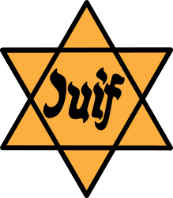
Learning About the Holocaust

Slide 3
How did Hitler rise to power?
Economy was weak because of stock market crash and WWI debt
Germans’ confidence was low as they lost the war and were blamed for it
Lack of confidence in democratic government
Desperate for better life and improvements in country
Jan.1933, Hitler, leader of the Nazi party, was appointed as the head of the German government

Slide 4
When Hitler rose to power, what kind of government did he establish?
He changed Germany into a one-party dictatorship
Abolished all individual freedoms
Organized the police power necessary to enforce Nazi policies
Used terror to achieve his goals
Lured by wages and comradeship, thousands of jobless men became Nazi Storm Troopers

Slide 5
Why did Hitler and the Nazi Party hate the Jews to the point of planning to exterminate the entire Jewish race?
Hitler was obsessed with ideas about race.
Believed all of history was a fight between races, which would end in the triumph of the superior Aryan race.
Considered the Jews a race whose goal was world domination and were a hindrance to Aryan dominance.
Pronounced that his race, what he considered the “master race” must remain pure in order to one day take over the world.
The ideal "Aryan" was blond, blue-eyed, and tall.
Genealogical table for evidence of Aryan ancestry for five generations cause of Adolf Hitler‘s Holocaust (persecution of Jews).

Slide 7
Percentage of Jews killed in each country
POLAND 91%
AUSTRIA 35%
USSR 36%
BELGIUM 45%
NORWAY 45%
LUXEMBOURG 55%
ROMANIA 84%
ESTONIA 44%
A Total of 6,000,000 Jews
HUNGARY 74%
BOHEMIA 60%
YUGOSLAVIA 81%
LATVIA 84%
NETHERLANDS 71%
LITHUANIA 85%
GERMANY 36%
FRANCE 22%
GREECE 87%
Notes:
How did they manage to get together all these Jews to kills them?
How did they kill them when they had them?
To begin with there were concentration camps.

Slide 8
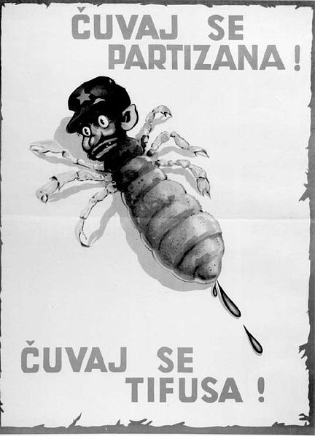
Anti-Semitism
Jews do not share the Christian belief that Jesus is the Son of God.
The Church taught that Jews were responsible for Jesus' death.
Anti-Semitism was extremely strong in Europe where the Jewish population was very large.
Jews were blamed for the defeat in the War.
Many Germans were poor and unemployed and wanted someone to blame.
Germans turned on the Jews, many of whom were rich and successful in business.

Slide 9
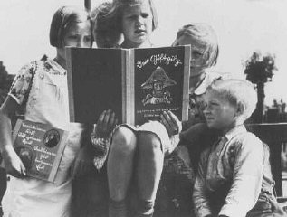
How did the Nazi Party convince the German people to hate and eventually allow the killing of 6,000,000 Jewish people and 5,000,000 non-Jewish people?
Took control of all forms of communication in Germany.
Viewpoints threatening to Nazi beliefs were eliminated from all media.
Any person who was not loyal to the Nazi Party was persecuted.
Textbooks taught students blind obedience to the party, love for Hitler, and anti-Semitism.

Slide 10
How did the Nazis know who was Jewish?
• Census in 1933 had “race” as a category
• Their clothes and practices made them look different.
• Synagogues and temples kept birth, marriage, and death records.
• Neighbors /friends turned on them so they could claim rewards.
• I.D. cards labeled Jews with a “J”

Slide 11
Were Jews the only people that were targeted?
Groups include:
Gypsies
Opponents of Nazism
Jehovah’s Witnesses (their religion prohibited them from swearing any oath to the state), homosexuals
Criminals
Mentally ill.

Slide 12
What is the “final solution” and how was it implemented?
"Final Solution" was the Nazi plan to exterminate the Jewish people and was implemented in stages:

Slide 13
Boycott the Jews
In 1933 Jewish businesses and offices throughout Germany were boycotted.
The sign states: “Don't buy from Jews!”

Slide 14
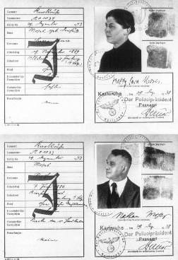
The Yellow Star
Jews were forced to wear a yellow Star of David with the word Juden (Jew) and carry identity cards.

Slide 15
Ghetto
Jews were moved from their homes into ghettos.
Structured like small towns, the Jews quickly adapted and created their own communities.
Purpose?

Slide 16
Nuremberg Laws
“Nuremberg Laws” proclaimed Jews second-class citizens.
This meant what?
A sign posted in front of a fence that reads, "Jews are not wanted here. Jews are our misfortune."

Slide 17
Deportation
1942: Jews were deported to six extermination camps established former Polish territory.
The "Final Solution" consisted of gassings, shootings, random acts of terror, disease, and starvation.

Slide 18
Did the Jews in Europe realize what was going to happen to them?
Deportees were always told that they were going to be "resettled."
Conditions better than ghettos.
Secrecy.
Rumors were unbelievable

Slide 19
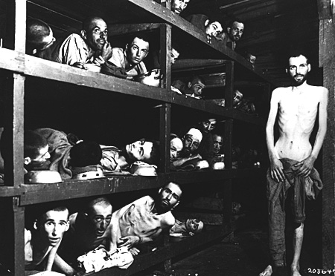
Elie Wiesel during the Holocaust – Author/narrator of Night.
Former prisoners of the "little camp" in Buchenwald stare out from the wooden bunks in which they slept three to a "bed."

Slide 20
What were the conditions in the concentrations camps?
Concentration camps were forced-labor camps where prisoners were literally worked to death.
Crammed into windowless, non-insulated barracks, up to 500 in one building, inmates were jammed against one another.
A bucket was the only form of waste control.
Food was scarce ( watery soup with rotten vegetables, molded bread)
Malnutrition made prisoners easy targets for disease and dehydration.

Slide 21
A MAP OF THE CONCENTRATION CAMPS AND DEATH CAMPS USED BY THE NAZIS

Slide 22
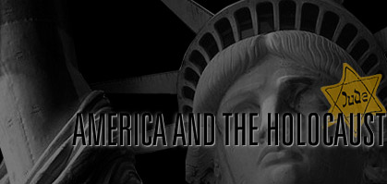
What was the response of the Allies and the United States to the persecution of the Jews? Could they have done anything to help?
The refugee policy made it difficult for refugees to obtain entry visas to the United States.
The U.S. State Department delayed publicizing reports of genocide.
By the spring of 1944, the Allies knew of the killing operations using poison gas at the Auschwitz-Birkenau extermination camp.
Jewish leaders pleaded unsuccessfully with the U.S. government to bomb the gas chambers and railways leading to the camp.

Slide 24
Vocabulary 5
1. Ghetto: City districts which isolated Jewish communities from non-Jewish communities.
2. SS: Special guards for Hitler also acted as the concentration camp guards.
3. Auschwitz: Largest camp established by the Nazi and was used for forced labor.
4. Aryan race: Germanic master race; blond hair blue eyes, pure German blood.
5. Final Solution: Implemented in stages, it was Hitler's plan to exterminate the entire Jewish population.

Slide 25
6. Genocide: Extermination of an entire group of people.
7. Anti-Semitism - Hostility toward Jews as an ethnic or religious group, often accompanied by social discrimination.
8. Propaganda- The deliberate spreading of ideas or information with the purpose of manipulating public opinion to gain support for one’s cause.
9. Holocaust: The genocide of European Jews and others by the Nazis during World War II.
10. World War II: 1939-1945 Hilter wanted to expand Germany thus invaded Poland.

Slide 26
Vocabulary Note Cards

Slide 27
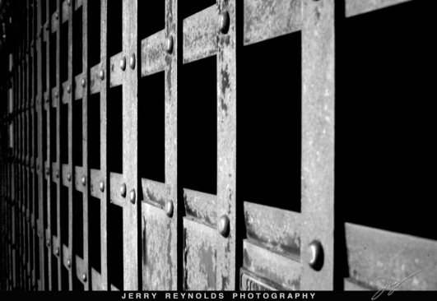
Example #1.

